Slide 1
Sample Business Project Plan
Sample Conversion to MS Teams Voice

Slide 2
Project Description
Sample Corporate Office is currently utilizing Cisco Unified Communications for Voice Services. The purpose of this project plan is to outline how Sample Implementation Company will transition Sample Corporate office from CUCM to MS Teams Voice Services.

Slide 3
Project Scope
Sample Corporate office to migrate to MS Teams Voice in Phase 1
Sample Implementation Company to streamline Voice Services to allow for a more modern technology-driving experience for our business users
Deploy MS Teams Voice Services to Sample Branches in Phase 2
Notes:
May require more than one slide

Slide 4
Objectives
This document will offer guidance to deliver a standardized method for deploying MS Teams Voice across the Sample Organization within a phased approach.
  Technical objectives
    To deliver a robust strategy regarding transitioning our Sample business users to MS Teams Voice. The goal is to decommission Sample’s Call Manager and ensure all services are operable such as e911 services to Sample Corporate office and all Sample Branches.
    To test Voice Services via a Pilot approach with our Sample Business Users within the Sample Network

Slide 5
Deliverables
Voice Services via MS Teams Voice to Corporate Office phase 1
  No Auto-Attendant or Call Queue.
  Port Existing phone numbers over to intelepeer
  Configure each Sample business user via Intelepeer and Teams Tenant with phone number and e911 Services
Voice Services via MS Teams Voice to Sample Branches – 29 Sites – Phase 2
  Deploy MS Voice to 2 Branches per Day
  Create an Auto Attendant/Call Queue for Each Sample Branch to approve member experience
  Sample to determine if they will keep existing phone numbers
    Recommendation: Port Branches Main Number to intelepeer – Transition the main number to an Auto Attendant; Port all branch employee phone numbers to intelepeer and assign their existing phone number to their MS Teams Client. - $$$ Savings on purchasing all new numbers.
      Note*** about 10 numbers have been ordered for Sample Tenant for testing purposes.
    Sample Auto Attendant for Sample Havana Branch: +1 720 419 3389 – This would be put in place for each Branch resulting in an improved member experience.

Slide 6
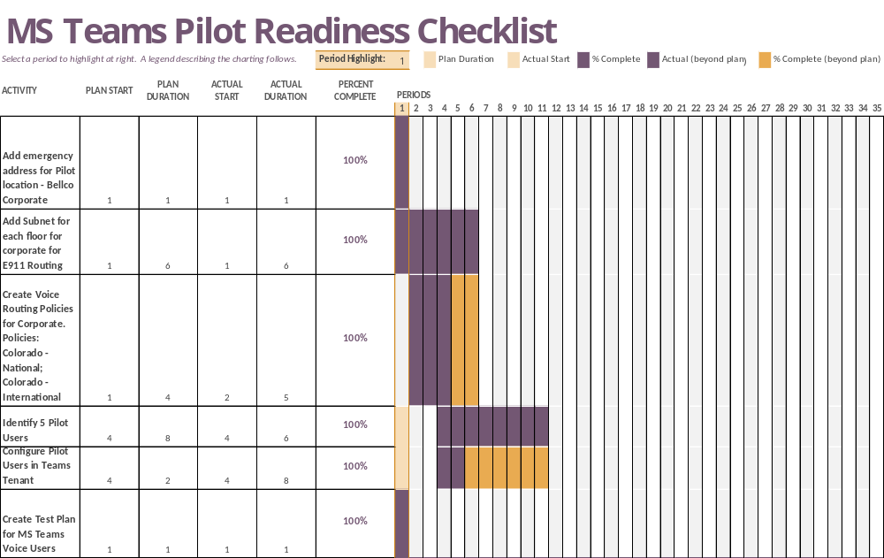
Fundamentals – Already Completed in Sample Teams Tenant

Slide 7
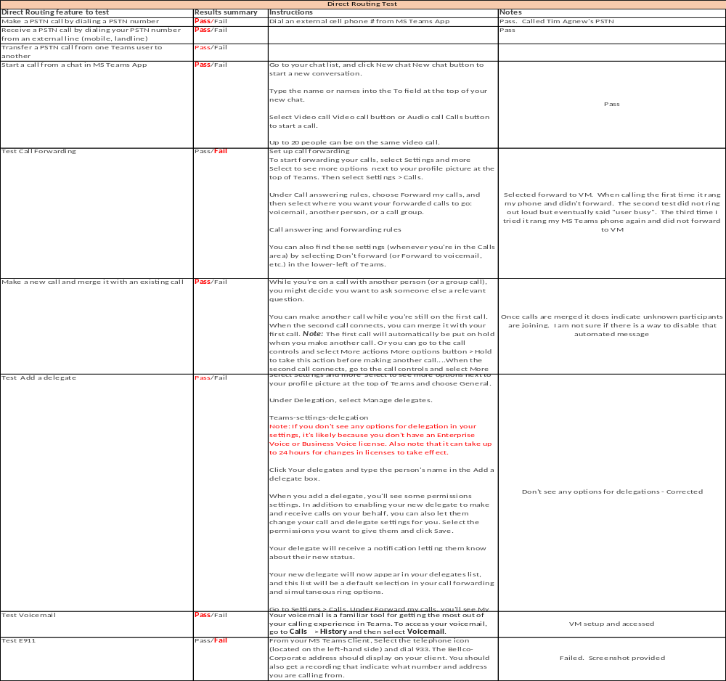
Pilot Testing Results
Test results available upon request. All tests passed except Call-forwarding from MS Teams Client and e911 works partially

Slide 8
Roadblocks and Corrective Actions
Call Forwarding is inoperable from Sample MS Teams Client
  Intelepeer Recommends Sample Business users to forward calls via a portal
    Reached out to Kathy from zlinq to schedule a meeting with Sample Implementation Company and Intelepeer for them to resolve issue prior to go-live
E911 – Works Partially
  When dialing 933 test line for emergency services, it does state the phone number and location, however there is an error message that indicated location does not have a sufficient Confidence level and if 911 was to be called, it will first be delivered to the national call center for screening and routed to the appropriate public safety route point
    Will need to get the Network Team involved. Possible issues:
      Pilot User is not on the subnet list that I placed in MS Teams admin center. Network will need to provide a list of ALL business users subnets. They will need to determine what subnet each user is on and those subnets will need to be added to MS Teams Sample Tenant
      The Pilot User’s Public IP address is not listed in the MS Teams admin Center.
        Network Team to identify –or- each business user can identify their public IP address: www.whatismyIP.com

Slide 9
Project Team Roles and Responsibilities
[Is this a project yet?] Project Manager
Chris Riggle
Director -Voice & Collaboration
Cloud Revolution
Vendor
Intelepeer
Carrier
James Gallagher
Voice Manager
Sandrina Mosley
Senior Voice Engineer

Slide 10
Implementation - Corporate
Tasks/activities
  Determine how many Sample Corporate Business users there are
  Determine phone numbers for each Sample Business User
  Place Port Request 45 days prior to Go-Live Date
    Port request will take 30 days
    With a collaborative approach with the Team, End users should be configured on day 30
Tools/technology
  Determine phone number assignments via cucm
  Create Users via Sample Teams Tenant/Intelepeer
Project change control process
  See internal Sample Implementation Company process – This will need to be utilized for porting
Notes:
May require more than one slide

Slide 11
Resources
People
Voice Team
Zlinq – Porting or ordering new numbers
Equipment
MS Teams admin center – Sample
Hard Phones
Has it been determined who gets hard phones?
Locations
Sample Corporate
Sample Branches
Outside Services
Voice teams to set up users
Notes
Cloud Revolution – Vendor
Intelepeer - Carrier
Notes
Notes
Notes

Slide 12
Project Schedule and Milestones
Port Phone Numbers or Obtain new numbers
Configuration of Business users - Corporate
Phase 2 Rollout of MS Teams Voice, Auto Attendants, and Queues to Branches
Go Live
Date: TBD
Date: TBD
Date TBD
Date TBD

Slide 13
Risk Management Plan
Risk | Probability | Impact | Owner | Mitigation Plan
Porting may affect project scope or schedule. | Medium | High | Project Manager | See appendix for a phased implementation plan

